Slide 1
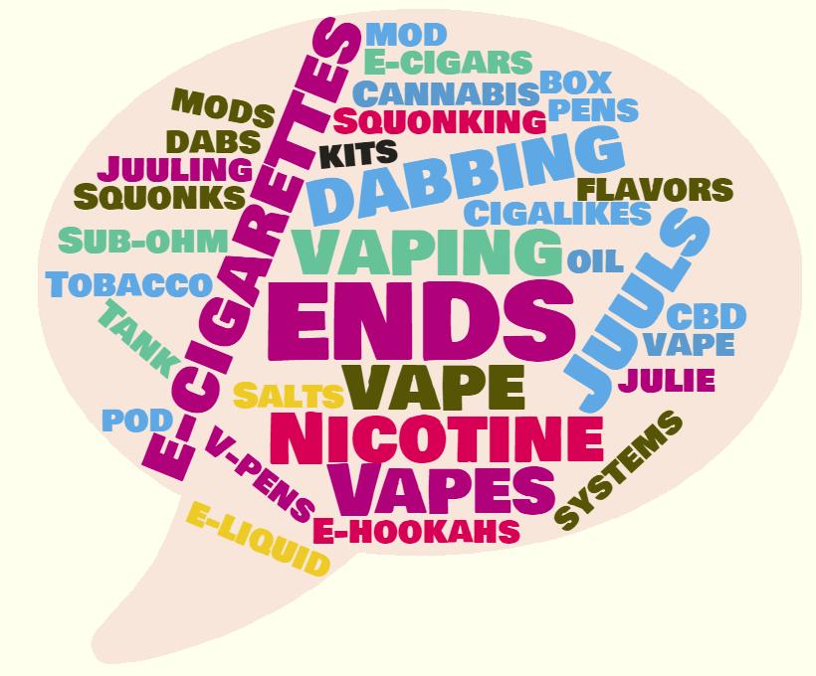


Electronic Nicotine Delivery Systems (ENDS)
August 27, 2019
Vaping Resource Workgroup

Slide 2

Tobacco Products Overview: Definitions
    Electronic Nicotine Delivery Systems, or ENDS, was adopted by the CT legislature as the term for e-cigarettes when the first legislation (re: exposure to secondhand smoke) was passed. We use it here to cover all “vaping” products.
    Tobacco Products are defined by the US Food and Drug Administration (FDA) as “any product that is made or derived from tobacco and is intended for human consumption.” *
E-cigarettes and other ENDS devices are included in the definition
*FDA-approved nicotine replacement therapies for tobacco use cessation are not included in this definition.
  Combustible cigarettes = the “old fashioned’’ ones that you light with a match (a.k.a. conventional)
Notes:
We have to start with some boring stuff to explain some of the terminology:
We use tobacco term overall for the majority of products that contain nicotine………remember nicotine comes from tobacco so all products with nicotine are tobacco products.
CT uses the umbrella term “ENDS” for all of the nicotine delivery devices that have proliferated the market
ENDS is not classified as a tobacco product in CT which mostly affects their tax status – there is no tax on ENDS
Definitions are very important when it comes to policies and laws, and the ever-changing terminology and product names make it very hard to keep up in a variety of areas including advertising and sales restrictions.

Slide 3


Tobacco’s Toll in Connecticut
Tobacco use is the leading preventable cause of death, killing 4,300 people a year in Connecticut.
Tobacco use costs Connecticut $2.03 billion in health care costs each year.
Nearly 90% of lung cancer deaths, 1 in 3 cancer deaths and nearly 1 in 3 deaths from heart disease are tobacco related.
95% of adult smokers began before they turned 21.
56,000 kids alive today in Connecticut will die prematurely from tobacco use.
Big Tobacco spends $72 million per year in Connecticut alone marketing their products.

Slide 4


State Progress… and Challenges
Adult smoking has decreased nationally from 42% in 1965 to 14% in 2017.
Approximately 18.4% of adults use tobacco in Connecticut. 12.7% of adults smoke cigarettes in CT. (BRFSS, 2017)
Nationwide, high school smoking rates have decreased from 36% in 1997 to 8.8% in 2017. (CT Youth Tobacco Survey)
3.5% of CT high school students reported current use of cigarettes in 2017, down from 25.6% in 2000. (CT Youth Tobacco Survey)
14.7% of high school students in Connecticut reported current e-cigarette use in 2017, a 50% increase in just two years. (CT Youth Tobacco Survey)
$4.35/pack State Cigarette Tax, versus national average of $1.81/pack.
$0 in funding dedicated towards tobacco control spending outside of Medicaid since 2015.
Notes:
Connecticut received $500.8 million (estimated) in revenue from tobacco settlement payments and taxes in fiscal year 2019. (Truth Initiative)
Connecticut is ranked 2nd in the U.S. for its cigarette tax of $4.35 per pack (enacted December 2017), compared with the national average of $1.81. (The District of Columbia has the highest tax at $4.50 and Missouri has the lowest at 17 cents.)
All other tobacco products are taxed at 50% of the manufacturer’s list price. ^{(Truth initiative)}

Slide 5
What is Happening in Connecticut
The Connecticut Department of Public Health reported in the 2017 Youth Tobacco Survey electronic cigarette use more than doubled among high school students from 7.2% in 2015 to 14.7% in 2017. This number is expected to go up in 2019.
This year 6 Connecticut high school students became ill and were transported to the hospital after vaping while at school. Adulterated cannabis liquid is suspected in at least 2 of the cases.
The legislature and the governor took action passing Public Act 19-13, titled: AN ACT PROHIBITING THE SALE OF CIGARETTES, TOBACCO PRODUCTS, ELECTRONIC NICOTINE DELIVERY SYSTEMS AND VAPOR PRODUCTS TO PERSONS UNDER AGE TWENTY-ONE.
As of October 1, 2019, you must be at least 21 years old to purchase tobacco, an electronic cigarette or vapor product.
Notes:
Connecticut received $500.8 million (estimated) in revenue from tobacco settlement payments and taxes in fiscal year 2019. (Truth Initiative)
Connecticut is ranked 2nd in the U.S. for its cigarette tax of $4.35 per pack (enacted December 2017), compared with the national average of $1.81. (The District of Columbia has the highest tax at $4.50 and Missouri has the lowest at 17 cents.)
All other tobacco products are taxed at 50% of the manufacturer’s list price. ^{(Truth initiative)}

Slide 6
What is Happening Nationally
As of September 25, 2019, the CDC reports 530 confirmed and probable cases of lung disease associated with e-cigarette product use, or vaping, reported by 38 states, including Connecticut, and the U.S. Virgin Islands.
Nine total deaths have been confirmed in seven states: California, Illinois, Indiana, Kansas, Minnesota, Missouri and Oregon.
While this investigation is ongoing, the CDC recommends that people should consider not using e-cigarette products.
The FDA is planning to ban all flavors including mint and menthol flavored electronic cigarette fluid.
Nationally in 2019 27.5% of high school students reported using electronic cigarettes.
Notes:
Connecticut received $500.8 million (estimated) in revenue from tobacco settlement payments and taxes in fiscal year 2019. (Truth Initiative)
Connecticut is ranked 2nd in the U.S. for its cigarette tax of $4.35 per pack (enacted December 2017), compared with the national average of $1.81. (The District of Columbia has the highest tax at $4.50 and Missouri has the lowest at 17 cents.)
All other tobacco products are taxed at 50% of the manufacturer’s list price. ^{(Truth initiative)}

Slide 7
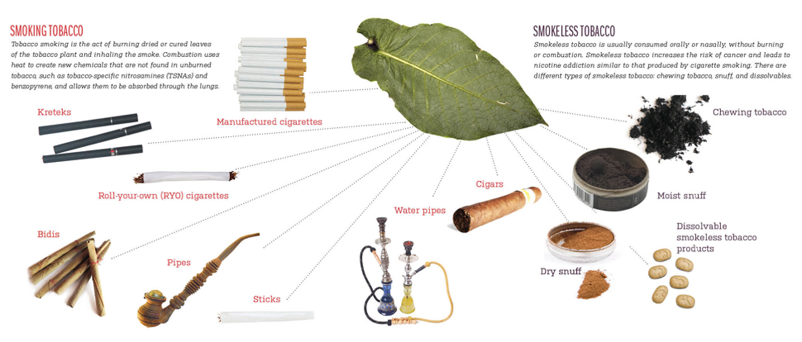
Don’t forget these tobacco products…
Dissolvables…..Roll-Your-Own …Kreteks……Bidis
Cigarettes……Cigarillos......Cigars…...Little Cigars.…..Hookah…...Dabs
Hookah…...Snus…...Smokeless…...Chew……Dip…...Snuff…...Pipes.….
Notes:
First, although we talk about ‘smoking’ and ‘cigarettes’ a LOT, we are worried about all kinds of combustible and non-combustible tobacco products!

Slide 8
CT Youth: Current
Tobacco Use
Overall Rate: 17.9%
of high school students
The bars to the right show the percent of high school students in each grade that reported using tobacco products in the past 30 days.
Grade 9 Grade 10 Grade 11 Grade 12
Source: 2017 CT Youth Tobacco Survey
Notes:
34.4% of high school students reported ever using tobacco products.

Slide 9
CT Youth: Current (past 30 day) Use of
Tobacco Products by Type
Source: 2017 CT School Health Survey – Youth Tobacco Survey

Slide 10
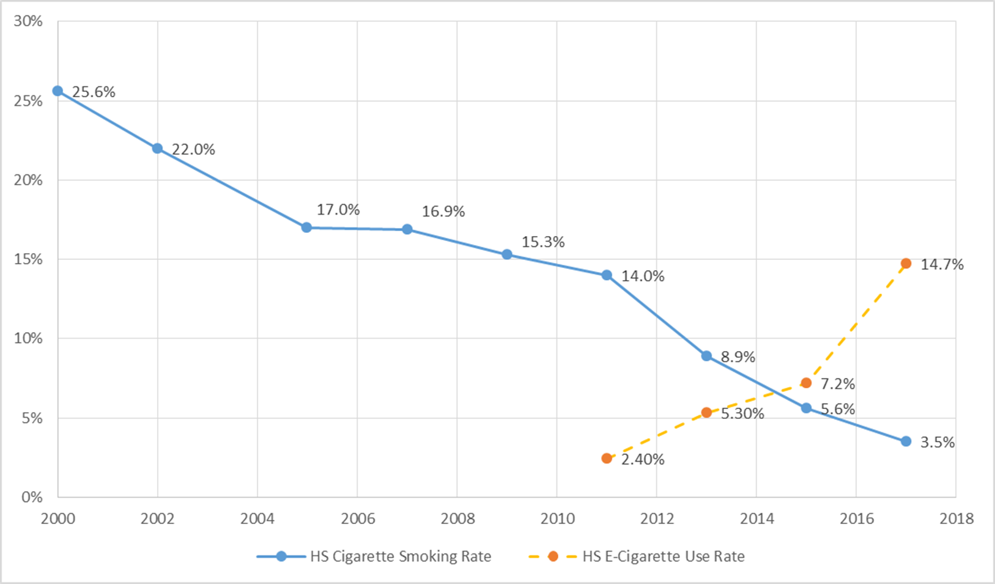
CT Youth Cigarette vs. E-cigarette Use
Source: CT School Health Survey-Youth Tobacco Survey 2000-2017

Slide 11
Tobacco Products Used by CT Adults
Source: 2015 CT Behavioral Risk Factor Surveillance System
Notes:
Note the disparity between women and men is not as wide on e-cigarettes as the other products.

Slide 12
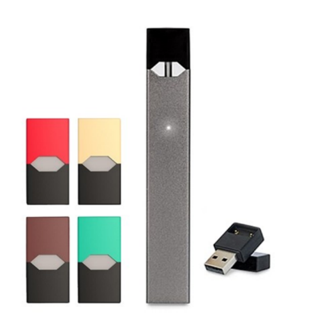
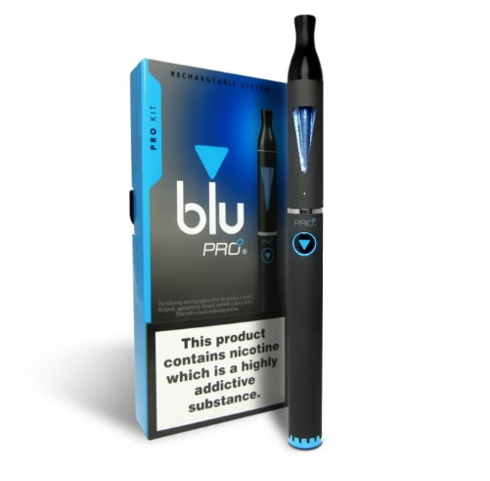
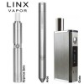
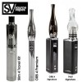


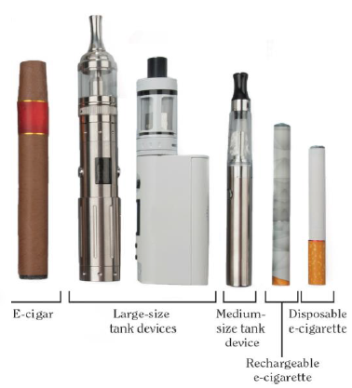
Juul
Suorin Drop
Notes:
A 2 mg Suorin pod contains the equivalent amount of nicotine as three packs of cigarettes

Slide 13

Electronic Nicotine Delivery Systems (ENDS)
= E-Cigarettes = Vapes …
E-cigarettes
Cigalikes
E-cigars
E-pipes
E-hookahs
Hookah pens and sticks
Shisha sticks
Vapes
V-pens
Vape pens
Juuls
Pod vapes
Mods, box mod kits
Tank systems
Squonks
ENDS
DID YOU KNOW?
Vaping is actually a misnomer.
ENDS create aerosol, not water vapor.
Aerosol is not harmless. It contains harmful and potentially harmful chemicals in addition to nicotine.
Notes:
Mods are systems that can be changed and customized.
Squonk kits are the most advanced vapes of the list. Technically a sub-category of box mod devices, squonk setups have become so popular lately that are now their own category.

Slide 14
Anatomy of a Pod-based System
These cartridges/pods contain
Cartridges/Pods
NICOTINE!
P
H
I
X
J
U
U
L
Devices with Rechargeable
Battery
Covers
Slide courtesy of:
tobaccopreventiontoolkit.stanford.edu
Notes:
Pod-based systems are made up of two components (click): the part on the left is the power source and contains the battery that can be charged through a USB port.
The smaller piece on the right is the pod or cartridge. A cartridge can provide at least 200 puffs and comes in a variety of different flavored e-juices, all with an alarming amount of nicotine.
These flavors and cartridge cover colors (click) are concerning since they attract young people.
(Click) Each JUULpod is packed with 59 milligrams per milliliter of nicotine, which is equal to the amount of nicotine found in a pack of cigarettes. A PHIX pod contains twice that amount………….
This is concerning because we know that the developing teen brain is very sensitive to nicotine and prone to addiction.
A pod holds it’s e-juice in the outer shell. When plugged into the battery piece the e-juice can be heated to produce an aerosol which is then inhaled into the lungs
References:
https://support.juulvapor.com/home/learn/faqs/juulpods-juice
https://phixvapor.com/pages/faq

Slide 15
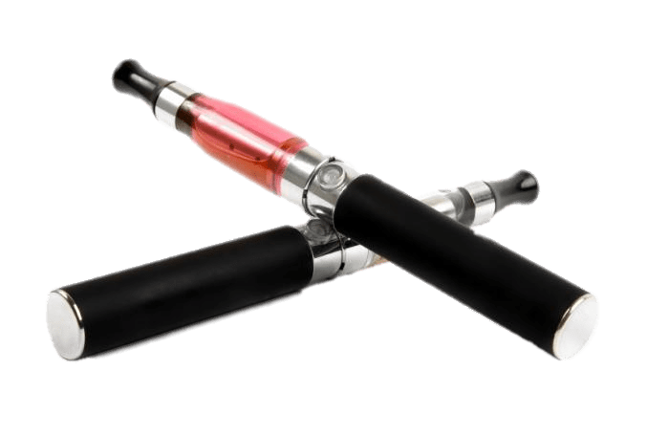
How do ENDS work?
Electronic cigarettes are battery-powered devices that deliver nicotine and/or flavoring to the user in the form of an aerosol (not water vapor)
  The device heats the liquid to form an aerosol which is inhaled by the user
  E-Liquids, when heated, may form additional harmful compounds that are also inhaled by the user
  E-Liquids typically use propylene glycol and/or glycerin as the solvents for the nicotine and flavoring chemicals
    Although these elements are deemed safe in food products, they have not been tested for safety when heated and inhaled into the lungs.
Notes:
ENDS aerosol is not a water vapor and is not harmless.
It can contain harmful and potentially harmful elements in addition to nicotine.
Carcinogens (formaldehyde, acetaldehyde, acrolein) and toxic heavy metals (lead, cadmium) have been found in ENDS aerosols
Ingredient levels vary, due to the lack of manufacturing standards, ingredient levels vary

Slide 16

What’s in Your E-cigarette?
  Most ENDS contain nicotine, the addictive drug found in other tobacco products
  The amount of nicotine in ENDS varies widely, based on the e-liquid, the temperature of heating, and the depth of the puff
  Nicotine salts can be vaped at lower temperatures for a smoother experience, which allows users to consume higher levels of nicotine with less harshness on the throat
ENDS can also be used as a delivery system for marijuana and other illicit drugs
50.6% of CT youth reported using their device with a substance other than nicotine, such as marijuana, THC or hash oil, or THC wax. (2017 CT Youth Tobacco Survey)

Slide 17
Chemicals Identified in Electronic Cigarettes
Exposure to chemicals in RED can be especially harmful to the health ✔= chemicals emitted in secondhand smoke
2-butanone (MEK)
2-furaldehyde
Acetaldehyde
Acetic acid
Acetone
Acrolein
Aluminum
Barium
Benzene ✔
Boron
Butanal
Butyl hydroxyl toluene
Cadmium
Chromium
Copper
Crotonaldehyde
Diacetyl ✔
Diethylene Glycol ✔
Formaldehyde ✔
Glyoxal
Glycerin
Iron
Isoprene ✔
Lead
Limonene
m,p-Xyelen
Magnesium
Manganese
Nickel
Nicotine ✔
N-Nitrosonornicotine ✔
o-Methylbenzaldehyde
p,m-Xylene
Phenol
Polycyclic Aromatic Hydrocarbons
Potassium
Propanal
Propylene Glycol
Sulfur
Tin
Toluene
Valeraldehyde
Zinc
Zirconium
Notes:
44 chemicals and still counting. Benzene is found in car exhaust
Even the chemicals that are viewed as less harmful in their natural states, or viewed as safe in food products (propylene glycol and/or glycerin, for example) may produce harmful byproducts or effects when heated and/or inhaled.
Heavy metals

Slide 18

What is Juul?
Juul is a popular brand of pod-based electronic nicotine delivery system that emerged on the market in 2015;
JUUL accounts for over 78% of ENDS sales (as of December 2018), up from less than 5% when it was introduced in 2015;
It’s small footprint and sleek look make it a popular choice for youth (it looks like a flash drive!);
All Juul pods contain nicotine: a .7ml cartridge contains 59 mg/ml, the same amount in a pack of cigarettes;
Only 37% of youth and young adults who use Juuls recognize that Juuls always contain nicotine.*
*Source:Truth Initiative and the Arizona Office of the Attorney General, 2018
Notes:
Most e-liquids on the market contain 36 mg/ml or less, however 57% of the e-cigarette products confiscated in an Arizona high school were found to have extremely high nicotine content (over 44 mg/ml); most of these were pod-based systems*

Slide 19
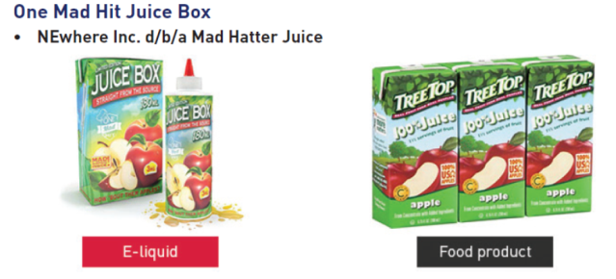
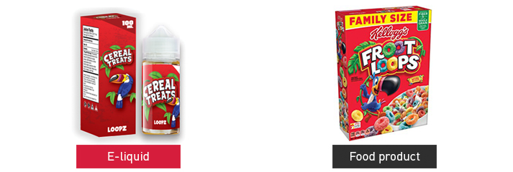
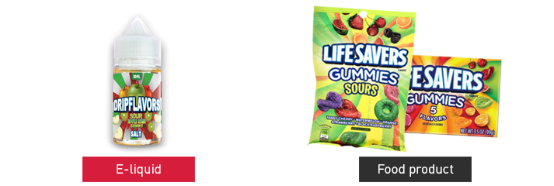
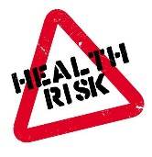

E-juice and Flavorings
There are now more than 15,000 flavors of e-liquids;
  81.5% of youth currently using e-cigarettes said that they used e-cigarettes “because they came in flavors I like” (Ambrose, et. al, 2015);
  Popular flavors for CT youth include: fruit, menthol/mint, candy/desserts and alcoholic drink flavors;
  The variety of candy and fruit flavored e-liquids and colorful product packaging are especially attractive to children;
  The CT Poison Control Center reports the most exposure calls for children under the age of 2 years, followed by teens and young adults, with inhalation and ingestion most common;
  Flavoring agents include diacetyl, which may cause lung disease when inhaled.
Did you know:
Diacetyl is used to create the buttery flavors like vanilla, caramel, and cupcake, and is also used as the buttery chemical in microwave popcorn.
Workers in a microwave popcorn factory developed a lung disease after inhaling diacetyl.
Diacetyl has been linked to deaths and hundreds of cases of irreversible lung damage.
Diacetyl has since been removed from popcorn, but not e-cigarettes.
Notes:
Volatile organic compounds (VOCs) such as benzene (a known carcinogen), formaldehyde, and toluene
Ultrafine particles that can be inhaled deeply into the lung
Heavy metals such as nickel, tin, and lead

Slide 20

The Health Effects of ENDS on Youth
The nicotine in E-liquids is toxic;
Vaping has caused middle and high school youth to become ill during the school day, reporting nausea, vomiting, and other symptoms;
ENDs are not strongly regulated, and there is still much unknown about the short and long-term effects of e-cigarette use;
Young people who use e-cigarettes are at risk for long term effects due to exposure to nicotine. These effects include:
    Learning and cognitive deficits, memory, attention;
    Mood disorders and impulse control;
    Increased susceptibility to addictions – nicotine and other substances.
    Teens who vape are three and half times more likely to smoke cigarettes³ and almost three (2.7) times more likely to use marijuana.
Did You Know:
Adolescence is a critical time for brain development.
Puberty to age 25 is the 2nd highest period of brain growth, after the first five years.
Sources: E-Cigarette Use Among Youth and Young Adults: A Report of the Surgeon General 2016; Berry, et al. 2019; Hongying, et.al, 2019.
Notes:
Nicotine disrupts the development of brain circuits that control attention and learning
Nicotine addiction can occur within one to two days, or even a puff

Slide 21


ENDS and Smoking Cessation
  Current evidence has been deemed insufficient by the FDA to approve ENDS for tobacco cessation. Research is mixed on effectiveness for cessation.
  Studies show that using an e-cigarette is only less harmful if not used in combination with combustible tobacco.
      Some smokers transfer addiction from one product (combustible cigarettes) to another (ENDS).
      Many become ‘dual users’ and continue to use both e-cigarettes and combustible cigarettes and/or other forms of tobacco.
  Recommended interventions for tobacco use cessation include: in-person counseling, telephone counseling, self-help materials, nicotine replacement therapy (NRT).
ENDS are not an approved cessation device!
Notes:
This complicates the ability to educate parents since there is such a strong vaping community that has been misled to believe the vaping is harmless.
SAFER does not mean SAFE
If adults transition altogether might be better, but beginning use leads kids to a lifetime of addiction, health issues
FDA-approved pharmacotherapy for cessation medications = 5 nicotine replacement therapies (NRT) and 2 medications [for those aged 18 and over]

Slide 22


Tobacco Cessation Resources
    DPH sponsors a statewide tobacco use cessation telephone quitline: 1-800-QUIT-NOW or via CommitToQuitCT.com: https://committoquitct.com
    Truth Initiative’s smoking quit website: https://truthinitiative.org/what-we-do/quit-smoking-tools
    U.S. Department of Health and Human Services website: https://smokefree.gov with customized FREE online resources for: women, teens, veterans, seniors, and Spanish language resources
    Mayo Clinic FREE quit program for tobacco and e-cigarettes: BecomeAnEx: https://www.becomeanex.org

Slide 23


Quitting E-Cigarettes For Youth
This is Quitting
First of its kind e-cigarette quit program for youth/young adults;
Text based;
Developed with help of teens, college students and young adults who have already attempted to or successfully quit;
Free, confidential and anonymous;
27,000 youth/young adults enrolled in first five weeks!
Text “DITCHJUUL” to 887-09.
https://www.thetruth.com/articles/hot-topic/quit-vaping
https://truthinitiative.org/press/press-release/new-study-reveals-breakthrough-texting-program-aids-young-vapers-quitting

Slide 24

Marketing and Messaging
ENDS manufacturers (including Big Tobacco) are using an old playbook with great success
ENDS products are not yet regulated in the same way as other tobacco products
Lack of regulation over manufacturing standards, ingredients, and sales restrictions have helped to create a billion dollar and growing vaping industry.
A recent study found that Juul stood out from other e-cigarette companies by marketing its devices on social media platforms such as Twitter, YouTube, and Instagram.
  That marketing campaign was a big success, the study suggests, with Juul's social-media activities being "highly correlated" with sales.
Notes:
Tobacco advertising : encourages new users to start
Encourages users to maintain use and increase use
Discourages quit attempts
Encourages relapse in ex tobacco users.

Slide 25
Marketing Strategies from Big Tobacco
“Hitting the youth can be more efficient…because they are willing to experiment, they have more influence over others in their age group than they will later in life, and they are far more loyal to their starting brand.”
“A cigarette for the beginner is a symbolic act. I am no longer my mother’s child, I’m tough, I am an adventurer…. As the force from the psychological symbolism subsides, the pharmacological effect takes over to sustain the habit….”
-An executive at Philip Morris
(pulled from an internal document in 1957)
-
Source: Housatonic Valley Coalition Against Substance Abuse (HVCASA)

Slide 26

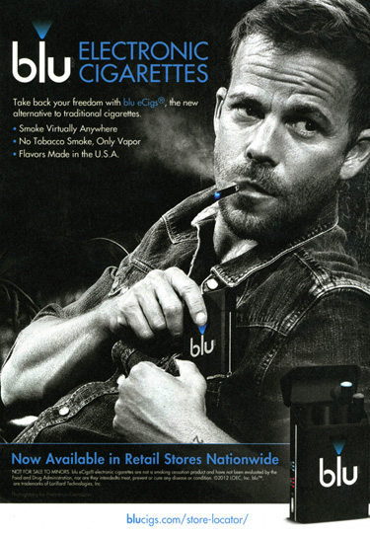
Philip Morris used the cowboy image on its commercials because the image “would turn the rookie smokers on to Marlboro… the right image to capture the youth market’s fancy… a perfect symbol of independence and individualistic rebellion.”
The Marlboro cowboy was chosen “because he is close to the earth. He’s an authentic American hero. Probably the only one. And it worked….”
Source: Housatonic Valley Coalition Against Substance Abuse (HVCASA)

Slide 27
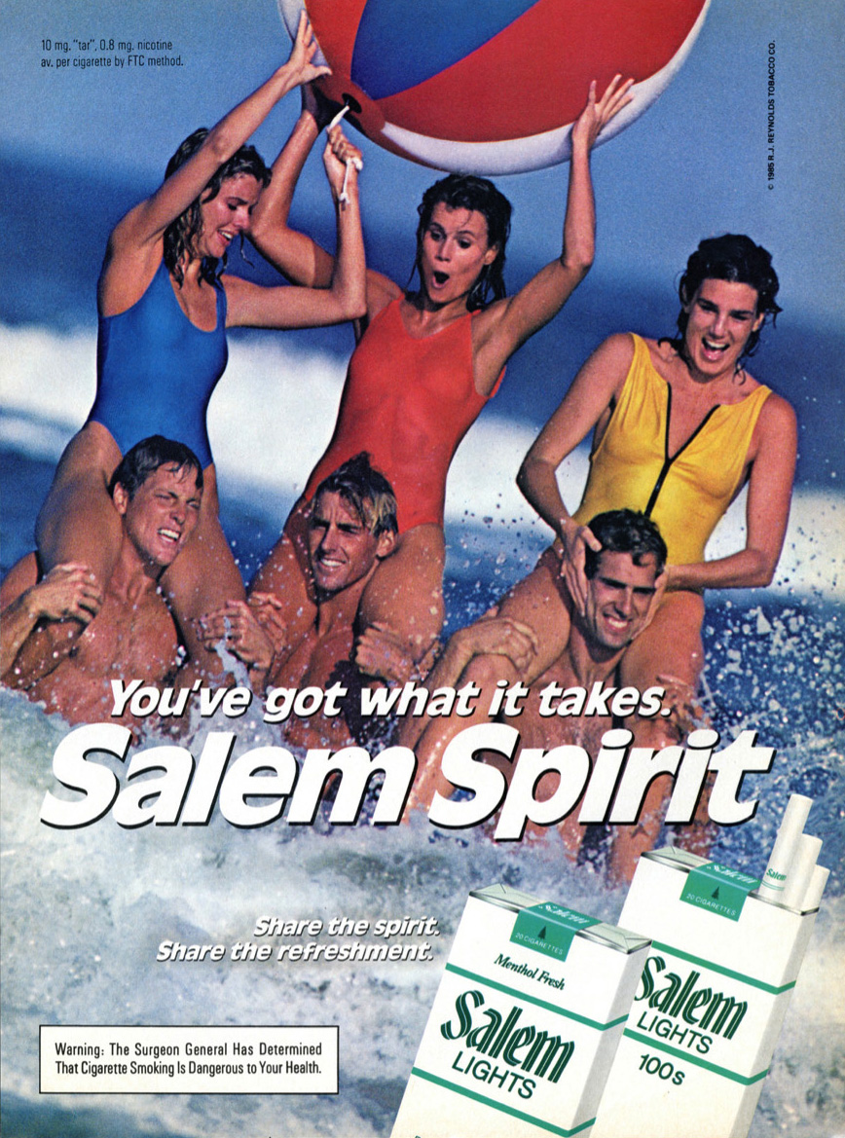
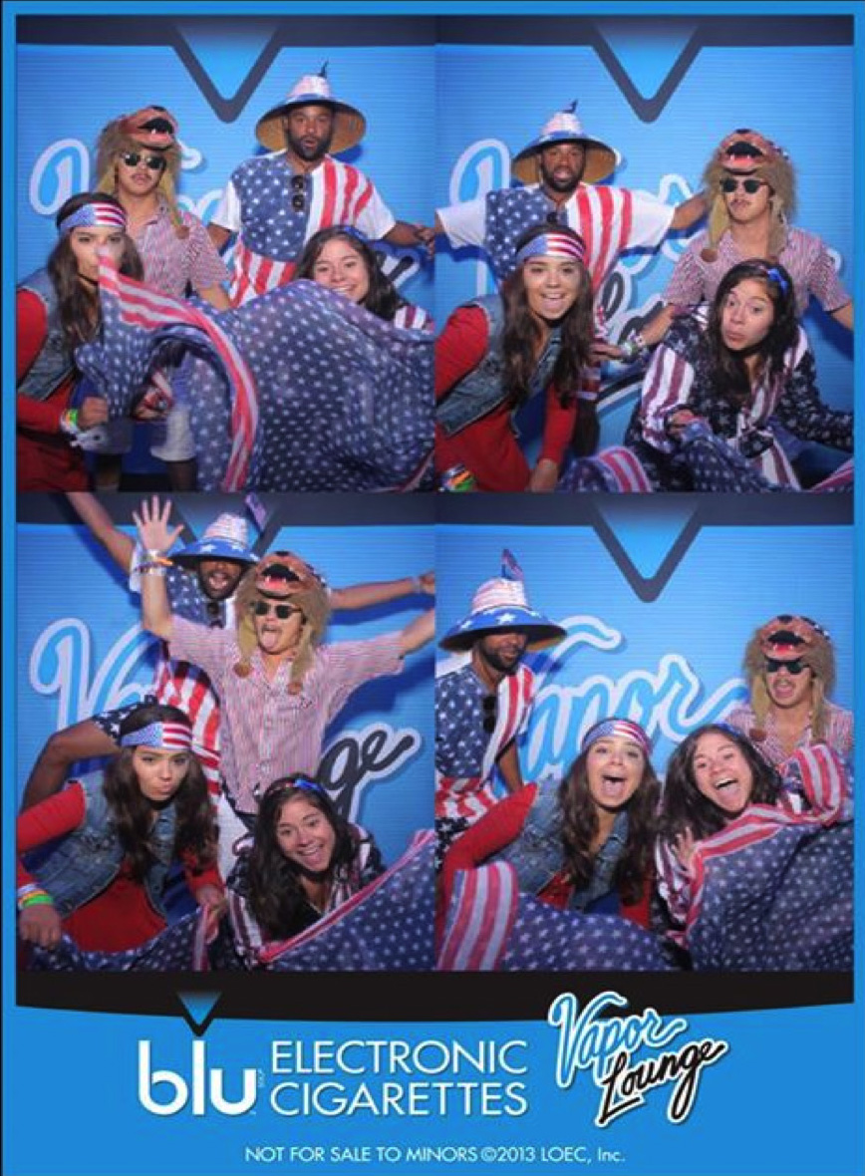
Similar marketing strategies, geared toward young consumers
Source: Housatonic Valley Coalition Against Substance Abuse (HVCASA)

Slide 28
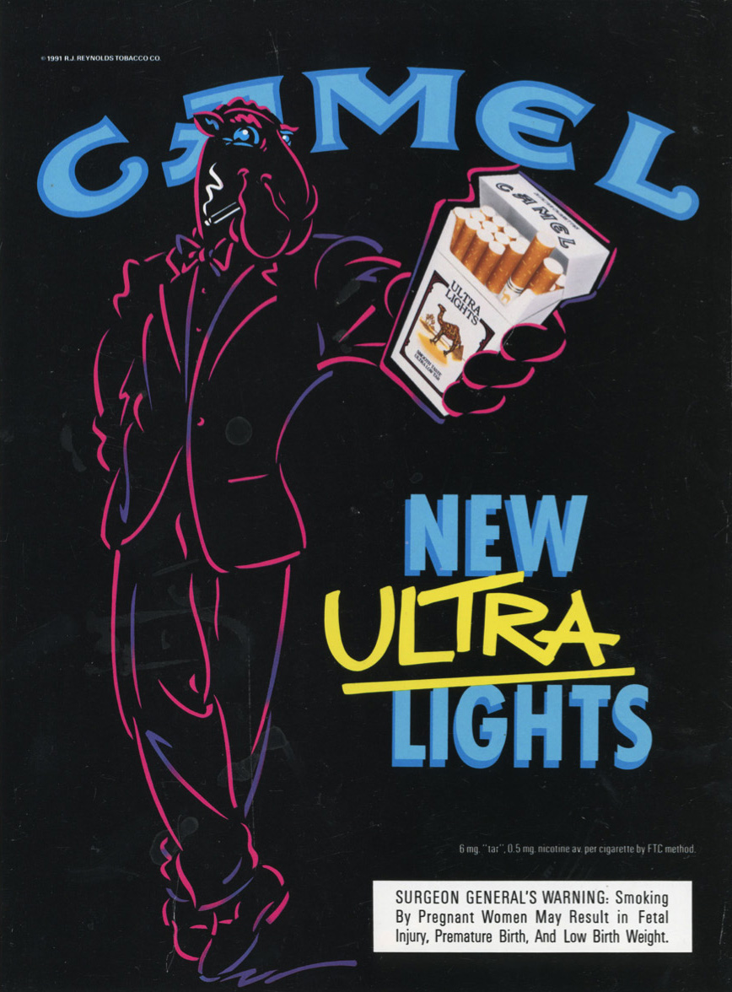


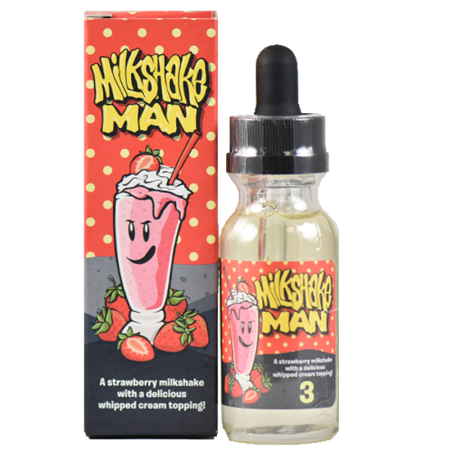
Similarities in marketing approaches between cigarettes and e-cigarettes include use of fun-loving, comical characters, bright colors, and graphics that appeal to young consumers.
Source: Housatonic Valley Coalition Against Substance Abuse (HVCASA)

Slide 29

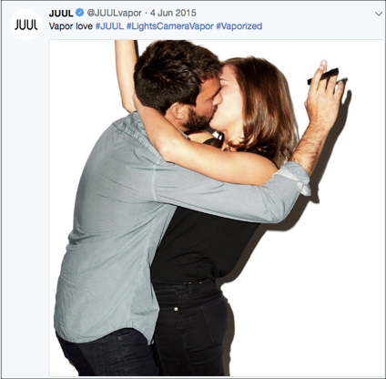
Juul’s Marketing Strategies to Youth
  Product launched through sampling events at
  concerts and movies.
  Early “Vaporized” marketing campaign in 2015
    Showed “20-somethings”, (not adults), in ads;
    Borrowed images from tobacco marketing;
    Exploited social media – young people forward to friends & followers;
    Paid social media influencers, people with large number of followers, to post on social media;
    Created Juul #hashtags to drive social media, connect to other posts.
  Juul terminated Instagram and Facebook accounts in Nov. 2018
  Now youth and 3rd party companies drive social media. Ex: Vaping juice company #juul.
Notes:
Reference:
Vox.com, Julia Belluz, Jan. 25, 2019, The vape company Juul said it doesn’t target teens, Its early ads tell a different story.
Jackler, M.D., Robert K., et al. JUUL Advertising Over its First Three Years on the Market, Stanford Research into the Impact of Tobacco Advertising Stanford University School of Medicine, Jan. 31, 2019
NPR.org, Susie Neilson, July 3, 2019, Juul doesn’t need to advertise to young people. Everyone else is doing it for them.
Czaplicki L, Kostygina G, Kim Y, et al. Characterising JUUL-related posts on Instagram, Tobacco Control Published Online First: 02 July 2019. doi: 10.1136/tobaccocontrol-2018-054824

Slide 30
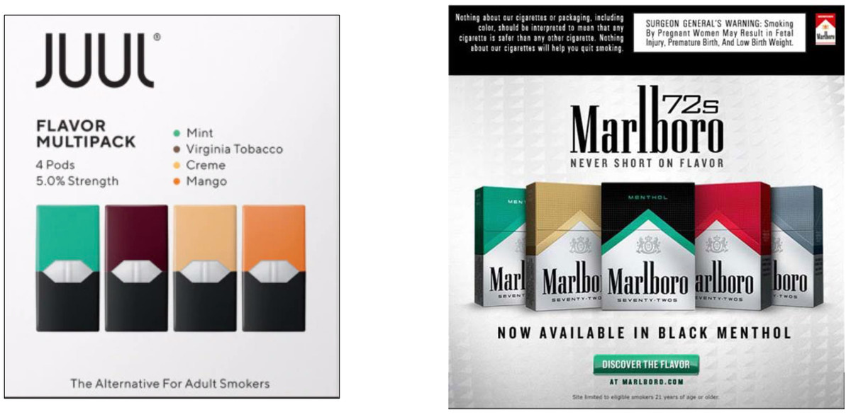

Some examples of Juul’s ad marketing
as compared
to Marlboro’s

Slide 31
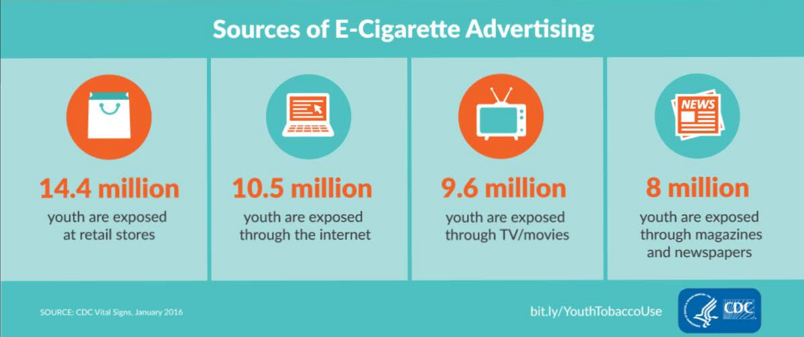

Slide 32
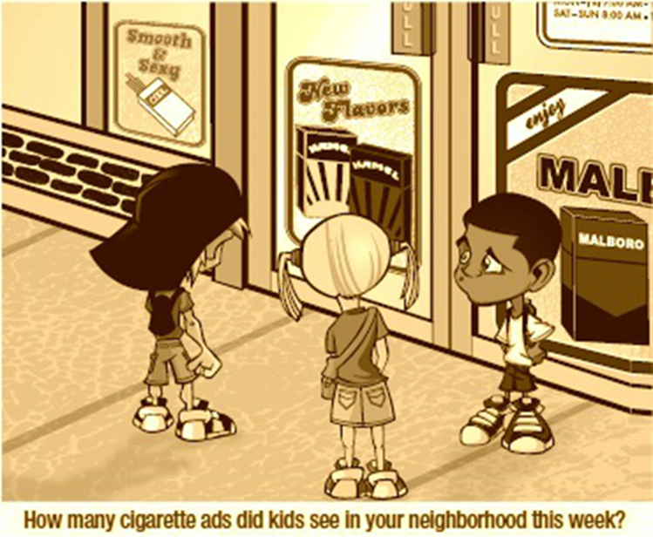
Connecticut High School Students’
Exposure To Advertisements
49.1% knew they were exposed to ads and promos for tobacco products in stores
16.8% saw tobacco use on tv or in the movies
11.6% were exposed to ads and promos for e-cigarettes on the internet, in print, or on television
Source: the 2017 CT Youth Tobacco Survey

Slide 33

Current Connecticut Laws
Smoking, ENDS use, any similar device may not be used on school property when school is in session or when student activities are being conducted.
[CT Clean Indoor Air Act: State Statute §19a-342 and §19a-342a]
Municipalities have the authority to reduce smoking and tobacco use on their properties. [State Statute §7-148 (f)]
  School districts have implemented complete property policies, 24/7
  Some district policies still need updated language to cover vaping
There is NO “RIGHT” to smoke or vape.
Smokers are not a protected class.

Slide 34
Tobacco & ENDS Products Regulation in Connecticut
CT Public Act No. 19-13:
Prohibits the sale, giving or delivery of any cigarettes, tobacco products, Electronic Nicotine Delivery System and vapor products to persons under age 21.
Fines for sales or delivery increased to not more than $300 (1st offense), $750 (2nd offense within 24 months), $1,000 (3rd offense within 24 months.)
Fines for person under 21 misrepresenting their age $50 (1st offense) and between $50-100(2nd offense).
Extends smoke free locations (schools, restaurants, government buildings, etc.) to ENDS.
Requires proof of age for accepting delivery of ENDS.
IDs everyone who appears under age 30.

Slide 35



ENDS Use: What Can We Do About It?
Parents
Be tobacco free: it’s never too late to quit.
Talk to your kids about why ENDS are unsafe
Tell them you do not want them to use ENDS
Schools
Administrators:
Communities
Implement evidence-based prevention strategies that are known to reduce tobacco use, including:
pricing
Raising the tobacco sale age to 21 is a promising strategy that has been implemented statewide and will take effect October 1, 2019.
100% Tobacco (not smoke) free school and grounds policies: 24/7/365.
Set clear rules that discourage ENDS use
POLICIES.
It is illegal to sell tobacco or vapor products to anyone under 21.
Teachers:
Watch for ENDs use and enforce school policies.
Help students to understand the hazards of ENDS use.
Youth prevention education in schools should follow best practice recommendations
strong smoke-free laws and policies
Social marketing campaigns to increase perception of risk/harm
Adopting tobacco-free/vape-free policies and promoting tobacco free lifestyles is still a best practice.
Notes:
Youth are especially susceptible to price
The less youth see smoking/vaping, the less likely they are to use.
9 out of 10 adult smokers begin by age 18.
Bridgeport, Hartford, Milford, Southington, South Windsor, Trumbull and Wallingford prohibit the sale of tobacco products to those under age 21. (Truth Initiative)

Slide 36
Top Ten Facts About Vaping
1. Nearly all vape devices, including Juuls, contain nicotine, which is highly addictive and toxic to the human body.
2. 1 Juul pod contains the same amount of nicotine as 1 pack of cigarettes.
3. Nicotine is a potential gateway drug that primes the brain for other addictions, affects impulse control and learning, causes mood disorders and changes the adolescent brain.^{1,2}
4. Teens who vape are three and half times more likely to smoke cigarettes^{3,} and almost three times (2.7) more likely to use marijuana⁴.
5. The original messaging about ENDS indicated that it was ‘harmless water vapor’, however it is really an aerosol, and many of the products tested contain toxic chemicals, including formaldehyde and heavy metals.
6. There are currently over 15,000 flavors of vapes on the market, many developed and marketed in a way that attracts youth users. The flavors themselves can be toxic.
7. The e-cigarette/vape industry has strong ties to Big Tobacco, and is manipulating youth, often through social media, into thinking their products are harmless and not addictive.
8. Vape devices can be used for marijuana and other harder drugs. More than 50% of CT high school students who ever tried vaping have used the device for substances other than tobacco that included marijuana, THC or hash oil, or THC wax.⁵
9. The long-term health risks of vaping are still unclear because they are still fairly new, but we do know vaping is associated with inflammation of the lungs and airways, respiratory problems.
10.It is against Connecticut law for anyone under the age of 21 to purchase vaping products. The fine for selling or distributing vape products to persons under the age of 21 starts at $300⁶.

Slide 37
Top Ten Facts: Sources
US Department of Health and Human Services. E-cigarette Use Among Youth and Young Adults: A Report of the Surgeon General . Atlanta, GA: US Department of Health and Human Services, CDC; 2016. Accessed July 27, 2018.
National Academies of Sciences, Engineering, and Medicine. 2018. Public Health Consequences of E-Cigarettes. Washington, DC: The National Academies Press. doi: 10.17226/24952 ; also Bold KW, Kong G, Camenga DR, et al. Trajectories of E-Cigarette and Conventional Cigarette Use Among Youth. Pediatrics. 2018;141(1):e20171832.
Berry KM, Fetterman JL, Benjamin EJ, et al. Association of Electronic Cigarette Use With Subsequent Initiation of Tobacco Cigarettes in US Youths. JAMA Netw Open. 2019;2(2):e187794. doi:10.1001/jamanetworkopen.2018.7794.
Hongying Dai, Delwyn Catley, Kimber P. Richter, Kathy Goggin, Edward F. Ellerbeck. Electronic Cigarettes and Future Marijuana Use: A Longitudinal Study. Pediatrics, May 2018, VOLUME 141 / ISSUE 5
Sorosiak, D., Metcalf Walsh, B., Peng, J. (2018). Connecticut Youth Tobacco Survey Results; 2017 Surveillance Report. Hartford, CT: Connecticut Department of Public Health.
CT Public Act 19-13: An Act Prohibiting The Sale Of Cigarettes, Tobacco Products, Electronic Nicotine Delivery Systems And Vapor Products To Persons Under The Age Of 21.

Slide 38

CT Resources
CT Department of Mental Health & Addiction Services (DMHAS)
Vaping Resources information and resources
https://www.ct.gov/dmhas/cwp/view.asp?a=2912&q=585848
CT Tobacco Prevention & Enforcement Program
https://www.ct.gov/dmhas/cwp/view.asp?a=2912&q=335154
CT Department of Public Health (DPH)
https://portal.ct.gov/DPH/Health-Education-Management--Surveillance/Tobacco/Tobacco-Use-Prevention--Control-Program
https://portal.ct.gov/DPH/Press-Room/Press-Releases---2018/High-School-Student-Vaping-Doubles-in-2-Years
CT Clearinghouse
http://ctclearinghouse.org or 1-800- 232-4424

Slide 39



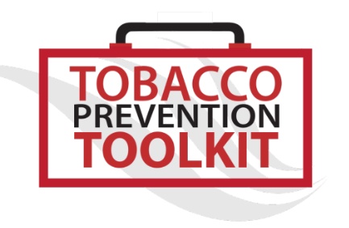
Other Resources
Centers for Disease Control and Prevention (CDC)
https://www.cdc.gov/tobacco/basic_information/e-cigarettes/index.htm
Food and Drug Administration (FDA) Center for Tobacco Products
https://www.fda.gov/tobacco-products/products-ingredients-components/vaporizers-e-cigarettes-and-other-electronic-nicotine-delivery-systems-ends
Campaign for Tobacco Free Kids
https://www.tobaccofreekids.org/what-we-do/industry-watch/e-cigarettes
Stanford University School of Medicine
Tobacco Prevention Toolkit (teaching modules include vaping)
https://med.stanford.edu/tobaccopreventiontoolkit/about.html

Slide 40
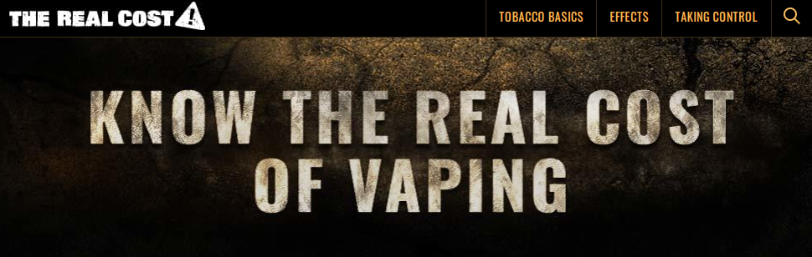

National Vaping Prevention Social Marketing Campaigns
The Real Cost
https://www.fda.gov/tobacco-products/public-health-education-campaigns/real-cost-campaign
Don’t Get Hacked
https://therealcost.betobaccofree.hhs.gov/gm/hacked-ends.html

Slide 41
The next slides are optional depending on your audience.

Slide 42
Parents & Caregivers
  Be tobacco free: it’s never too late to quit.
  Talk to your kids about why ENDS are unsafe.
  Tell them you do not want them to use ENDS.
  Know the Risks – Talk with Your Teens about E-Cigs: A Tip Sheet for Parents
  https://e-cigarettes.surgeongeneral.gov/documents/SGR_ECig_ParentTipSheet_508.pdf
  Vaping: What You Need to Know and How to Talk to Your Kids
    file:///C:/Users/mason/Downloads/What-You-Need-to-Know-and-How-to-Talk-to-Your-Kids-About-Vaping-Guide-Partnership-for-Drug-Free-Kids.pdf

Slide 43
Schools
Policy
  Does your policy include ENDS along with tobacco use?
  Does staff know the policy? Do they need training recognizing and referring students?
  Does your policy contain opportunities for intervention along with consequences?
Prevention education
  Does your school health education curriculum include ENDS?
  Does staff need training teaching and talking about ENDS with students?
  Can youth peer educators or advocates plan and implement prevention education for their peers or younger students?
Intervention
  What do you offer students who violate policy more than once or express interest in quitting ENDS use?
    Time limited group
    The Truth Initiative’s Quitting App
    https://www.thetruth.com/articles/hot-topic/quit-vaping
Stanford University School of Medicine
Tobacco Prevention Toolkit (teaching modules include vaping)
https://med.stanford.edu/tobaccopreventiontoolkit/about.html
Massachusetts
Making smoking history, Toolkit for schools http://makesmokinghistory.org/dangers-of-vaping/schools/
School

Slide 44

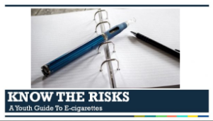
Prevention Education
FDA and Scholastic – The Real Cost of Vaping
(one session, gr. 9-12)
https://www.scholastic.com/youthvapingrisks/?utm_campaign=CTP%20News%3A%20TRC%20Magic%20Ads%20-%2072219&utm_medium=email&utm_source=Eloqua
CDC – Know the Risks: A Youth Guide to E-Cigarettes
https://www.cdc.gov/tobacco/basic_information/e-cigarettes/youth-guide-to-e-cigarettes-presentation.html
Stanford University School of Medicine – Tobacco Prevention Toolkit (includes vaping)
https://med.stanford.edu/tobaccopreventiontoolkit/about.html

Slide 45


Coalitions and Communities
Apply the Strategic Prevention Framework (SPF), data driven public health model
Assessment -
  Where can we get data about ENDS use and consequences in our community?
    Past 30 day use?
    Are there specific populations using more?
    Perception of risk?
    Perception of peer or parent disapproval?
    Where and how do youth obtain ENDS products?
Capacity Building –
  What do our coalition members and other community partners need to know about ENDS use?
  How can we prepare them to conduct prevention activities?

Slide 46


Coalitions and Communities
Strategic Prevention Framework (SPF), part 2
Planning
  What risk factors should we target? (Perception of risk, peer or parent disapproval)
  What strategies best target those risk factors?
    Look to tobacco control lessons – education, social marketing campaigns, policies, change access through new laws, etc.
Implementation –
  What is our plan for implementing prevention strategies?
  Who is responsible for implementing the prevention strategies – coalition members, educators, parents, youth?
Evaluation –
  Did we see a change in the risk factors or 30 day use?
  What might we do differently?

Slide 47
Community Prevention Strategies
Provide information on risk of tobacco & ENDS and promote cessation services through:
  Social media and social marketing campaigns
  Community forums and other trainings
  Community health fairs and other events
  Write op-ed articles in local newspaper
  Ask community partners to share information (health department, library, schools, etc.)
Conduct tobacco/ENDS merchant training to increase compliance with tobacco/ENDS sales laws
Partner with police department to conduct merchant compliance checks and recognize merchants who pass compliance checks. Offer training to those who do not
Provide and enforce signage related to tobacco/ENDS free policies including We Card signs to merchants
Restrict point of purchase/promotion
Review public/school policy pertaining to substance use and misuse
and include opportunities for intervention
Offer tobacco/ENDS intervention and cessation groups

Slide 48

U.S. Surgeon General’s Comprehensive Approach
Educate parents, teachers, coaches, health professionals and other influencers about risks of e-cigarette use among youth and youth adults
Curb e-cigarette advertising and marketing likely to attract youth and young adults
Develop e-cigarette and smoke free indoor air policies
Restrict youth access to e-cigarettes in retail settings
Require retail licensing and establish specific package requirements
Coordinate, evaluate and share best practices across state and local organizations
Support and reinforce e-cigarette regulations at the federal, state and local level
Address surveillance, research and evaluation gaps related to e-cigarettes
Source: CADCA Practical Theorist – Electronic Nicotine Delivery Systems: Juuling, Other Trends and Community Prevention (2019) quoting the US Dept. of Health & Human Services (2016) E-cigarette use among youth and young adults: A Report of the Surgeon General

Slide 49

Proven Prevention Interventions
From tobacco control efforts, which steadily reduced youth smoking in the past decade:
Youth-targeted mass-media counter marketing campaigns
Adoption of comprehensive smoke-free laws
Increased availability of accessible, affordable tobacco cessation options
Increased retail price of tobacco products through excise tax increases
Restrictions on advertising and promotion
Source: CADCA Practical Theorist – Electronic Nicotine Delivery Systems: Juuling, Other Trends and Community Prevention (2019) quoting the. US Dept. of Health & Human Services (2012) E-cigarette use among youth and young adults: A Report of the Surgeon General

