Slide 1




Personalized Prevention Approach to Problem Gambling
Terra Carbert
Recovering Compulsive Gamber Life Coach & Podcast Host
Date: May 15, 2023
Time: 2:00 p.m. Eastern Daylight

Slide 2




Friendly Reminders
While waiting for others to come in, here are some rules and reminders to keep in mind.
Please have camera on and use interactive tools throughout session
1
Feel free to type your questions
in the chat box.
2
No need to wait with questions we are discussing as we go.
3
Notes:
Encourage engagement from the beginning. Ask an icebreaker question to get people comfortable talking “What’s one thing you want to know about problem gambling or recovery from problem gambling

Slide 3

THIS PRESENTATION CONTAINS IMAGES OF GAMBLING ACTIVITY
BRIEF MENTION OF SUICIDAL THOUGHTS
DISCUSSION OF GAMBLING ACTIVITY
IMAGES OF GAMBLING ACTIVITY
IMAGE OF ALCHOHOL AND CIGARATTES
IF IT DOES NIGHT FEEL RIGHT AND SAFE FOR YOU TO STAY THAT’S OKAY PLEASE TAKE A BREAK IF YOU NEED TO

Slide 4


Learning Agenda
What we'll discuss this afternoon
Introductions
Who Is a Gambler
Risks for Problem Gambling & Opportunities for Intervention
Personalizing Your Approach to Prevention
Resources

Slide 5

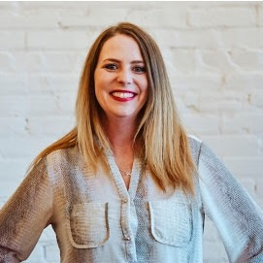
About the speaker
I’m Terra Carbert
I’ve been in recovery from problem gambling disorder since 2016.
Since finding recovery I have become enthusiastic about problem gambling awareness, supporting others in recovery and beyond. I also created a podcast called Ambitious Addicts where I host women in recovery from all addictions and all pathways who join me to share their experience, strength, and hope.

Slide 6



More Dangerous
Than You Might Think
High Suicide Risk
In clinical populations and in treatment services for problem gambling, between 22 and 81 percent of individuals have been found to have suicidal ideations, while between 7 and 30 percent of individuals have had suicide attempts.
https://www.st-va.ncbi.nlm.nih.gov/pmc/articles/PMC9645554/#:~:text=In%20clinical%20populations%20and%20in,attempts%20(9%E2%80%9316).
Notes:
Why you should care about gambling…personal story “last day gambling”

Slide 7





Pillars of Prevention
Stopping something before it starts | Reducing the amount of harm that results from a specific behavior. | Ensuring people have enough information to make healthy decisions. | Putting policies in place that keep people from harming themselves. | Reducing the public’s exposure to potential harm
Notes:
These are the pillars I want top of mind for each of you today as you think about the community you serve. Reference that there are other frameworks for prevention.

Slide 8




















Who is a Gambler
Notes:
Discussion about who is affected and why personalizing that approach is necessary – race, religion, gender, marital status, socio-economic status, geography, state climate for gambling, types of gambling engaged in….”no two gamblers are the same” then describe these things about self (white, middle aged, six-figure earner, raised middle class, Christian, white collar worker,

Slide 9


RISK FACTOR
EARLY WIN & EARLY EXPOSURE
PREVENTION OPPORTUNITY
  Limiting access to gambling for minors
  Implementing exclusion programs for those at risk of developing a problem
  Providing education on the risks of gambling
Notes:
Personal story, highlight what may have helped, Group discussion about experiences with early big wins and exposure

Slide 10




RISK FACTOR
ACCESSIBILITY
PREVENTION OPPORTUNITY
  Restricting the availability of gambling opportunities
  Limiting advertising of gambling products
  Increasing awareness about the potential harms of gambling & real data about true chances of a win
Notes:
Personal story about access, open discussion about availability of gambling in the community they serve

Slide 11


RISK FACTOR
LACK OF KNOWLEDGE
PREVENTION OPPORTUNITY
  Providing education and information about how gambling works
  Provide data on the risks associated with different types of games
Notes:
Personal experience about “lucky” thinking, signs, and lack of understanding of the odds of the games and that then leading to an obsession with the odds

Slide 12







RISK FACTOR
NOT MONITORING
TIME & MONEY
PREVENTION OPPORTUNITY
  Providing tools and resources to help people set and stick to spending limits & time limits
  Pre-commitment systems
  Self-exclusion programs

Slide 13

RISK FACTOR
FINANCIAL
PROBLEMS
PREVENTION OPPORTUNITY
  Providing financial education
  Provide resources to support for those experiencing financial problems due to gambling,
  Helping individuals create and stick to a budget

Slide 14



RISK FACTOR
BOREDOM, LONELINESS
& LIMITED INTERESTS
PREVENTION OPPORTUNITY
  Promoting healthy social activities and exploration of hobbies as an alternative to gambling,
  Encouraging individuals to seek professional help for mental health concerns
  Provide support group resources

Slide 15






RISK FACTOR
HISTORY WITH SUBSTANCE USE
PREVENTION OPPORTUNITY
  Educating individuals about the link between substance use and problem gambling
  Providing gambling knoweldge & resources and support for individuals with a history of substance use

Slide 16
Personalizing
Your Approach
Notes:
2-5 Scenarios, open Q & A

Slide 17
Get in Touch!
Terra Carbert
612-296-7794
terra@theselfidscoversisterhood.com
@selfdiscoverysisterhood
@ambitiousaddictspodcast
The Ambitious Addicts podcast can be found on all major podcasting platforms

Slide 18
RESOURCES & HANDOUTS

Slide 19
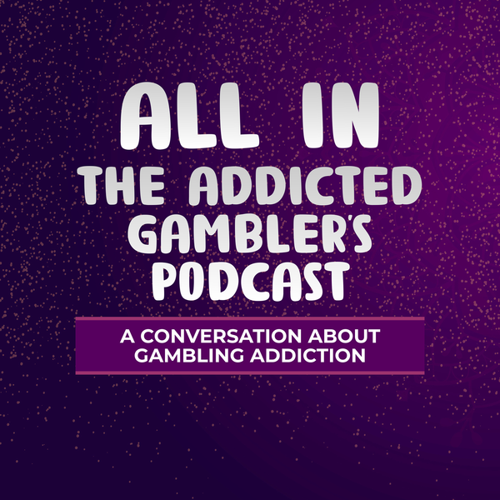

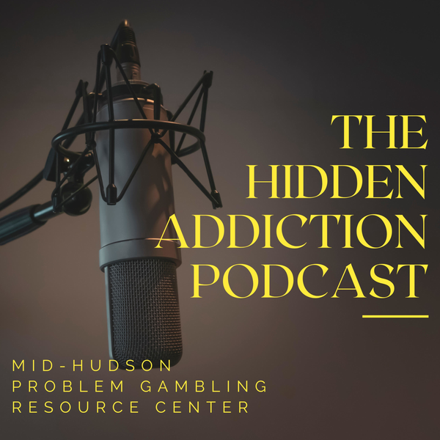
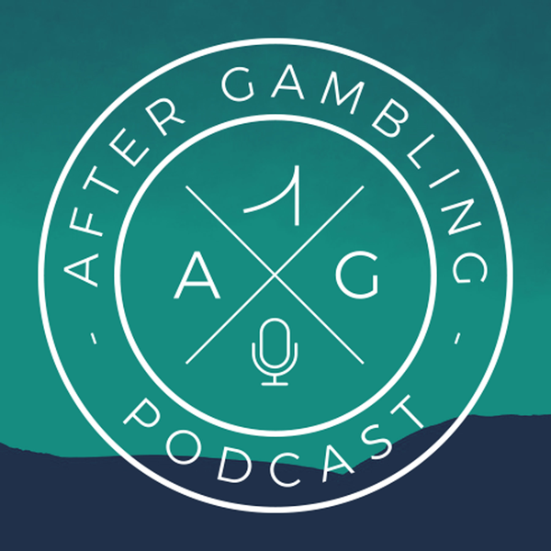


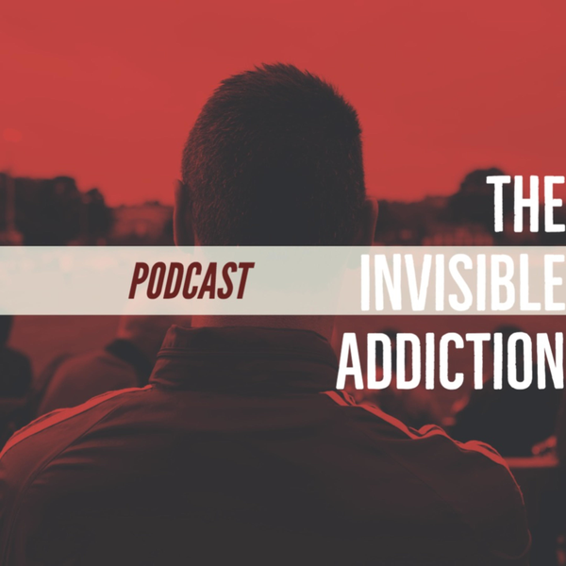
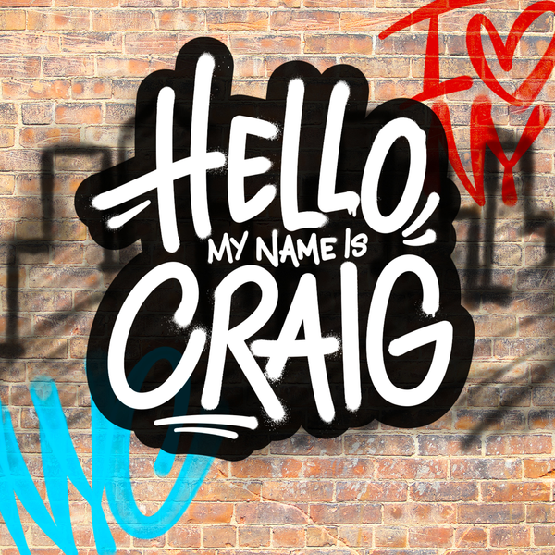



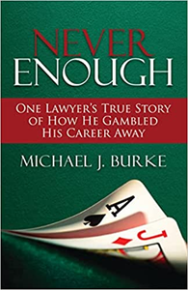
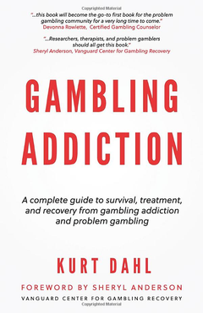
PROBLEM GAMBLING RESOURCES
PODCASTS
BOOKS

Slide 20
PROBLEM GAMBLING RESOURCES
FACEBOOK GROUPS
Gambling Addiction & Recovery – 1
Gambling Addiction & Recover – 2
Recovery Road Online
Broke Girl Society
Women Gamblers in Recovery
Recovery Road Online Women’s Group
SUPPORT GROUP WEBSITES
Gamblers Anonymous
Gamblers In Recovery
Recovery Road
Recovery Dharma
Celebrate Recovery
Smart Recovery
Game Quitters
Gam Anon
EDUCATIONAL SITES
National Council on Problem Gambling
Parents Gaming Glossary

Slide 21
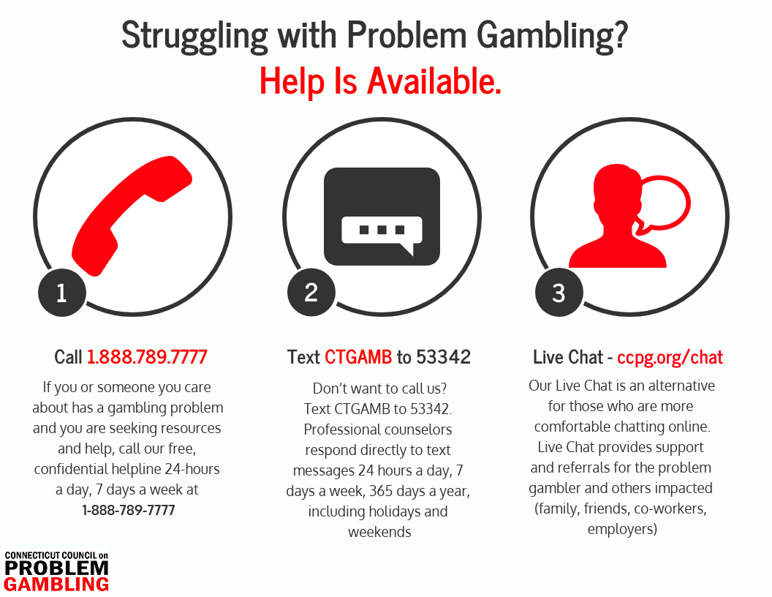
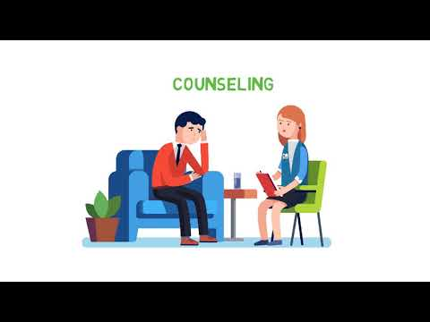
Help is Available

Slide 22
More
Regional Resources: Gambling
CT Community for Addiction Recovery (CCAR) https://ccar.us
Gambling Recovery Support Services: Stephen Matos (Smatos@mccaonline.com)
National Council on Problem Gambling Prevention Committee https://www.preventioncommittee.org/
CT Council on Problem Gambling: www.ccpg.org
DMHAS PGS: www.ct.gov/dmhas/pgs

Slide 23

DMHAS Problem Gambling Services Team
Jeremy Wampler
Jeremy.Wampler@ct.gov
Fiorigio (Fred) Fetta
Fiorigio.Fetta@ct.gov
Haley Brown
Haley.Brown@ct.gov
Kelly Leppard
Kelly.Leppard@ct.gov

Slide 24
Gambling Recovery Support Services in Connecticut
Gambling Recovery Support Services is an opportunity available to Bettor Choice participants, individuals in recovery, and those affected by problem gambling to connect with a person in recovery with lived experience with gambling.
Connecticut Recovery Support Specialists are available to provide gambling outreach, resources, educational training opportunities, and recovery speakers for your upcoming meetings or events.
Speakers Bureau
Scholarships for Recovery Coach Academy and Recovery Support Specialist Training with Advocacy Unlimited
Link treatment and recovery support services
Provide Training for Behavioral Health Agencies
Please contact Stephen Matos for more information at smatos@mccaonline.com or 203-448-0144.
Gambling Recovery Support Services is coordinated by MCCA, Inc through funding from the State of Connecticut’s Department of Mental Health & Addiction Services, Problem Gambling Services Division

Slide 25
THANK YOU!!!

