Slide 1

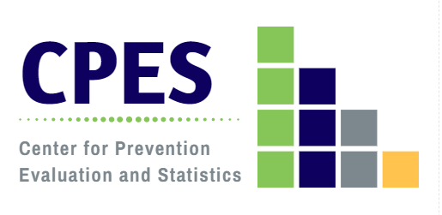

2018 Connecticut Community Readiness Survey Results:
CONNECTICUT
Developed by the Department of Mental Health and Addiction Services
Center for Prevention Evaluation and Statistics at UConn Health
October 2018

Slide 2
Connecticut Community Readiness Survey (CRS) Objectives
Assess perceived substance use problems at the local level;
Measure community readiness for substance abuse prevention:
  Community attitudes about alcohol and drug use, mental health promotion, and suicide and problem gambling prevention;
  Community support for prevention;
  Availability and perceived effectiveness of prevention strategies;
  Perceived barriers to substance abuse prevention;
  Use of data for substance abuse prevention;
  Rating of community readiness;
Develop a tool and methodology that DMHAS can use for ongoing needs assessment;
Inform substance abuse prevention planning and mental health promotion at state and regional levels;
Identify needs for training and technical assistance;
Provide data to evaluate the impact of SPF-based initiatives.

Slide 3
Connecticut Community Readiness Survey (CRS) Approach
Instrument developed through a consensus process involving DMHAS, its Resource Links, State Advisory Committee and UConn Health;
Administered biannually statewide since 2006;
Web-based survey implementation supplemented by paper surveys ;
CT Clearinghouse coordinates e-mail distribution of the survey;
Regional Behavioral Health Action Organizations (formerly Regional Action Councils) identify 5-10 key informants per town/city to survey;
RBHAOs conduct active outreach and follow up with key informants to encourage participation and maximize responses;
Data analysis by the DMHAS Center for Prevention Evaluation and Statistics at UConn Health;
State and regional results are disseminated to RBHAOs to support planning;
This approach resulted in 975 responses to the 2018 CRS survey statewide, with representation in 163 of 169 communities.

Slide 4
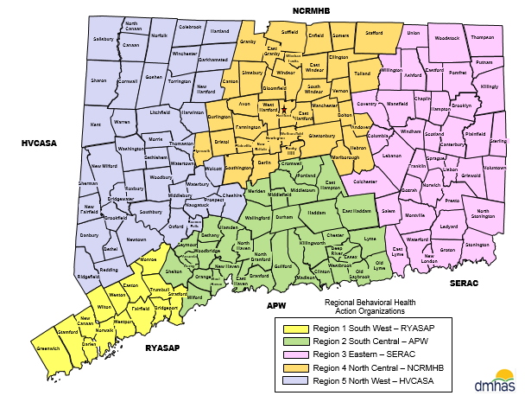
DMHAS Regional Behavioral Health Action Organizations (RBHAOs)

Slide 5
Key Informant Demographic Characteristics:
Connecticut CRS, 2018
Age
Gender
Race

Slide 6
Key Informant Stakeholder Affiliation:
Connecticut CRS, 2018

Slide 7
Problem Substances of Greatest Concern According to Key Informants By Age Group: Connecticut CRS, 2018
Notes:
Note for the 12-17 years old group for Tobacco: Of the 13%, 7.5% are concerned about e-cigarettes/vaping, while 5.4% are concerned about Tobacco.
For cases where the Other category was selected, the following recodes were applied.
Fentanyl = Heroin
Opiates/opioids = Prescription drugs
E-cigarettes, Juuling, vaping, nicotine = Tobacco

Slide 8
Community Attitudes Toward Substance Abuse Prevention
[Q10]: Connecticut CRS, 2018
Key Informant believes that most community residents ….

Slide 9
Community Attitudes Toward Substance Abuse Prevention
[Q10]: Connecticut CRS, 2018
Key Informant believes that most community residents ….

Slide 10
Key Informant Ratings of Substance Abuse Prevention Strategies in the Community [Q11]: Connecticut CRS, 2018

Slide 11
Key Informant Ratings of Substance Abuse Prevention Strategies in the Community [Q11]: Connecticut CRS, 2018

Slide 12
Perceived Barriers to Substance Abuse Prevention Activities in the Community [Q12]: Connecticut CRS, 2018

Slide 13
Key Informant Ratings of Community Readiness for Substance Abuse Prevention Planning Activities [Q13]: Connecticut CRS, 2018

Slide 14
Availability of Substance Abuse Prevention Data [Q14]: Connecticut CRS, 2018

Slide 15
Key Informant Ratings of the Community Stage of Readiness for Substance Abuse Prevention [Q15]: Connecticut CRS, 2018
Community Stage of Readiness for Substance Abuse Prevention: Connecticut (n=744) | Percent
1 - This town/city tolerates or encourages substance abuse. | .1
2 - This town/city has little or no recognition of the substance abuse problem. | 5.0
3 - This town/city believes that there is a substance abuse problem, but awareness of the issue is only linked to one or two incidents involving substance abuse. | 10.0
4 - This town/city recognizes the substance abuse problem and leaders on the issue are identifiable, but little planning has been done to address problems and risk factors. | 24.4
5 - This town/city is planning for substance abuse prevention and focuses on practical details, including seeking funds for prevention efforts. | 22.9
6 - This town/city has enough information to justify a substance abuse prevention program and there is great enthusiasm for the initiative as it begins. | 9.0
7 - This town/city has created policies and/or more than one substance abuse prevention program is running with financial support and trained staff. | 13.3
8 - This town/city views standard substance abuse programs as valuable, new programs are being developed to reach out to at-risk populations and there is ongoing sophisticated evaluation of current efforts. | 10.6
9 - This town/city has detailed and sophisticated knowledge of prevalence, risk factors, and substance abuse program effectiveness and the programming is tailored by trained staff to address risk factors within the community. | 4.7
Mean Stage of Readiness for Connecticut | 5.26

Slide 16
How important is it to prevent problem gambling in your community? [Q16]: Connecticut CRS, 2018

Slide 17
Community Ability and Support for Suicide Prevention
[Q17-Q19]: Connecticut CRS, 2018
93.5% of respondents agree that “suicide prevention efforts (such as educational programs, training, policies, and identification and referral of individuals at risk of suicide) are needed in the community.”

Slide 18
Community Attitudes Toward Mental Health Promotion
[Q20]: Connecticut CRS, 2018
Key Informant agreement that “most” community residents ….

